Slide 1
Deep Learning Based Motor Control Unit
Made By:
Abhinav Rai (13-BCS-0005)
Ashhar Hasan (13-BCS-0015)

Slide 2
Problem Statement
Majority of the locomotion controllers are generated using motion tracking data for a given combination of factors (environment, terrain, subject mass, subject anatomy etc.)
The locomotion controllers are not generic enough and cannot be reused across different terrains or be applied to anatomically different subjects.
We are creating a physics-based generic locomotion controller trained using Reinforcement Learning.
Generic locomotion controller for large number of tasks like Standing, Walking, Crouching and Gait including specific postures.

Slide 3
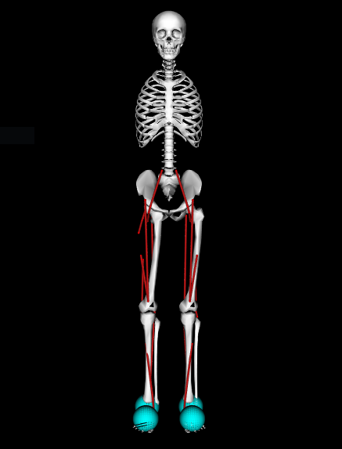
Human Model (OpenSim)
For our project we used a musculoskeletal model HUMAN with 18 muscles and 9 degrees of freedom.
All the muscles and joints can be indexed and accessed individually.
Each joint has the properties:
Position in the x, y, z space
Velocity
Acceleration
Apart from the joints, the center of mass of the entire body can also be accessed for the same properties.

Slide 4
Deep Deterministic Policy Gradient (DDPG)
DDPG is an actor-critic algorithm and uses two neural networks, one for the actor and one for the critic.
These networks compute action predictions for the current state and generate a temporal-difference (TD) error signal each time step.
The input of the actor network is the current state, and the output is a single real value representing an action chosen from a continuous action space.
The critic’s output is simply the estimated Q-value of the current state and of the action given by the actor.
The deterministic policy gradient theorem provides the update rule for the weights of the actor network.
The critic network is updated from the gradients obtained from the TD error signal.

Slide 5


Deep Deterministic Policy Gradient (DDPG)
Model-free algorithm based on DPG that can operate over continuous action spaces.
Action space has very high dimensionality in Deep Q-Learning and other algorithms.
A parameterized actor function $μ(s|θ^{μ})$ specifies the current policy by deterministically mapping states to a specific action.
The critic $Q(s,a)$ is learned using the Bellman equation.
The actor is updated by applying following rule:

Slide 6
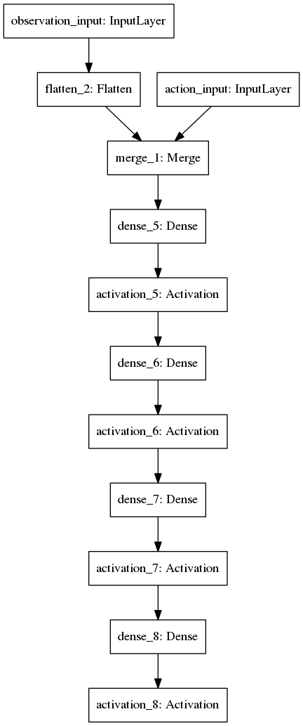

Actor Neural Network
Input layer.
3 layers of fully connected 32 units with rectifier activation function (relu).
$$f\left(x\right)=\max\left(0,x\right)≡ln⁡(1+e^{x})$$
1 layer of fully connected n units where n is the size of our action space (31) with sigmoid activation function.
$$f\left(x\right)=\frac{1}{1+e^{−t}}$$

Slide 7

Critic Neural Network
Input layer.
3 layers of fully connected 64 units with rectifier activation function (relu).
$$f\left(x\right)=\max\left(0,x\right)≡ln⁡(1+e^{x})$$
1 layer of a single unit with linear activation function.
$$f\left(x\right)=\left\{\begin{aligned}0, x<0 \\ &1, x≥0\end{aligned}\right.$$

Slide 8

Reward Function Design (Stand)
$acc$: Magnitude of acceleration of the center of mass.
$vel$: Magnitude of velocity of the center of mass.
$vsum$: Difference between initial $y_{head}$ and current $y_{head}$
$hsum$: Sum of $x$ component of head multiplied by 10 sum of $x$ component of both feet.
$legvel$: Magnitude of velocity of both feet.
$rew_{com}=acc+\left(vel∗10\right)+\left(vsum∗10\right)+hsum+legvel$
$rew_{norm}=100−\min\left(rew_{com},100\right)$

Slide 9

Reward Function Design (Stand on 1 Leg)
$acc$: Magnitude of acceleration of the center of mass.
$vel$: Magnitude of velocity of the center of mass.
$vsum$: Difference between initial $y_{head}$ and current $y_{head}$
$hsum$: Sum of $x$ component of head multiplied by 10 sum of $x$ component of both feet.
$legvel$: Magnitude of velocity of both feet.
$crouch$: Difference between head $y$coordinate and 1.25 multiplied by 20.
$rew_{com}=acc+\left(vel∗2\right)+vsum+\frac{legvel}{100}+crouch$
$rew_{norm}=120 −rew_{com}$

Slide 10

Reward Function Design (Crouch)
$acc$: Magnitude of acceleration of the center of mass.
$vel$: Magnitude of velocity of the center of mass.
$delta$: Difference between $y$ coordinate of pelvis and head.
$rew_{com}=\min\left(acc,10\right)+\min\left(vel,40\right)+\min{(\left(delta∗100\right)},50)$
$rew_{norm}=100−\min\left(rew_{com},100\right)$
The following rule is also applied if the $y$ coordinate of pelvis is above a threshold:
$$rew_{com}=rew_{com}+50$$

Slide 11

Training Phase
The muscles are activated based on a random function at $t=0$
The actor network reads the environment state and calculates the reward using the reward function which outputs a real number $\left[0, 1\right]$.
The actor network outputs a real number representing the action chosen from a continuous action space (in this case the muscle activation levels).
The critic network outputs a estimate of the Q-value.
An error is calculated from the actor and critic outputs and fed back into the neural network.
The process continues until either a predefined condition based on the environment state is reached or the given number of iterations are performed.

Slide 12

Runtime Phase
The trained model is loaded and weights for both the actor and critic networks is read.
The muscles are provided no activation at $t=0$.
The actor network reads the current environment state and choses an action from the learned set of actions using the reward function.
The process continues until a given number of iterations have passed or the environment has reached a termination condition.
The runtime phase differs from the training phase in that the critic network is not involved in estimating the Q-values and the error signals are not fed back to the networks.

Slide 13
Stand on Toes, One Leg, Normal Stand Models

Slide 14
Results
A table of the environment and the max reward observed and the maximum time that the model was able to retain the position.
Position | Max. Episode Reward | Max. Time
Stand | 498.0 | Robust
Crouch | 312.78 | 11s
Stand (One Leg) | 499.12 | Robust
Stand (Toes) | 412.78 | Robust

Slide 15
Future Scope and Improvements
Testing the generated models on non-uniform terrain.
Testing the generated models on human bodies of varying sizes and mass distributions.

Slide 16
Programming Environment and Tools Used
Python
TensorFlow
Keras-RL
Stanford OpenSim
Stanford Simbody
NumPy
SciPy
Scikit-Learn
OpenAI Gym

Slide 17
Thank You

